Slide 1
CRN Workshop Topic 2
November 2013
How geography and environment influence communications decisions

Slide 2
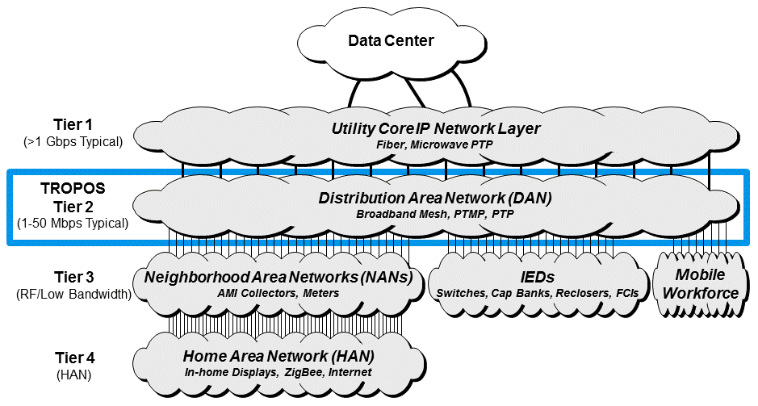
Distribution/field area networks
Reviewing the architecture
ABB
Tropos
Tropos Partners

Slide 3
Network Design Activity
Obtain GIS Data Sets
Many utility companies own a sufficient number of geographically distributed resources, such that all or most of the wireless network infrastructure can be implemented on assets that they own, manage, and control.
Most utility companies have invested in geographic information system (GIS) solutions to document and help manage their electric utility infrastructure and other facilities. Tropos begins the wireless distribution area network design effort with a review of the GIS data sets owned by the utility that are required for the design.
Tropos requests all available infrastructure asset information
Fiber-optic cable routes and Tier 1 network POPs (substations)
Vertical mounting assets (towers, streetlights, poles, etc)
Utility-owned facilities (offices, service centers)
Endpoint devices (meters, pump stations, RTUs, controllers, etc)

Slide 4
Network Design Activity
Design the Wireless Layers
Design the Tier 2 wireless network
Select locations for network capacity injection into the Tier 2 DAN
If copper or fiber-optic connection is available, locate the points-of-presence (POPs) and overlay them to the service coverage area map; the goal should be to utilize as many existing network connections as possible
If necessary, supplement the wired network with directional radios
Will the requirement be for licensed or unlicensed spectrum?
Conduct an RF analysis of the coverage area
Consider site acquisition requirements, pole and streetlight accessibility
If using Point-to-Point or PTMP radios, consider:
Tower availability
Antenna height restrictions
Sector coverage
Time synchronization
Power and modulation limits

Slide 5
Environmental Impact on Mesh Router Density
Elevation changes | Hilly environments can be challenging, requiring clever design and/or construction of towers High points can be advantageous for sparse rural deployments, allowing unobstructed long links
RF Environment | Spectrum analysis during the detailed design phase can steer frequency selection for directional radio systems, mesh layer Licensed directional links may be required Dual-band mesh may be required in order to avoid interference in unlicensed spectrum
Street layout | Curvy streets limit signal propagation, requiring more routers than gridded, straight streets Tree-lined median areas can cause obstructions
Trees | Areas with heavy foliage require more routers Consider seasonal change impact on foliage density (deciduous or evergreen)
Building Materials | Concrete and raw mineral surfaces diffuse RF signal instead of reflecting Steel and glass structures reflect signal and can be used strategically in wireless design

Slide 6
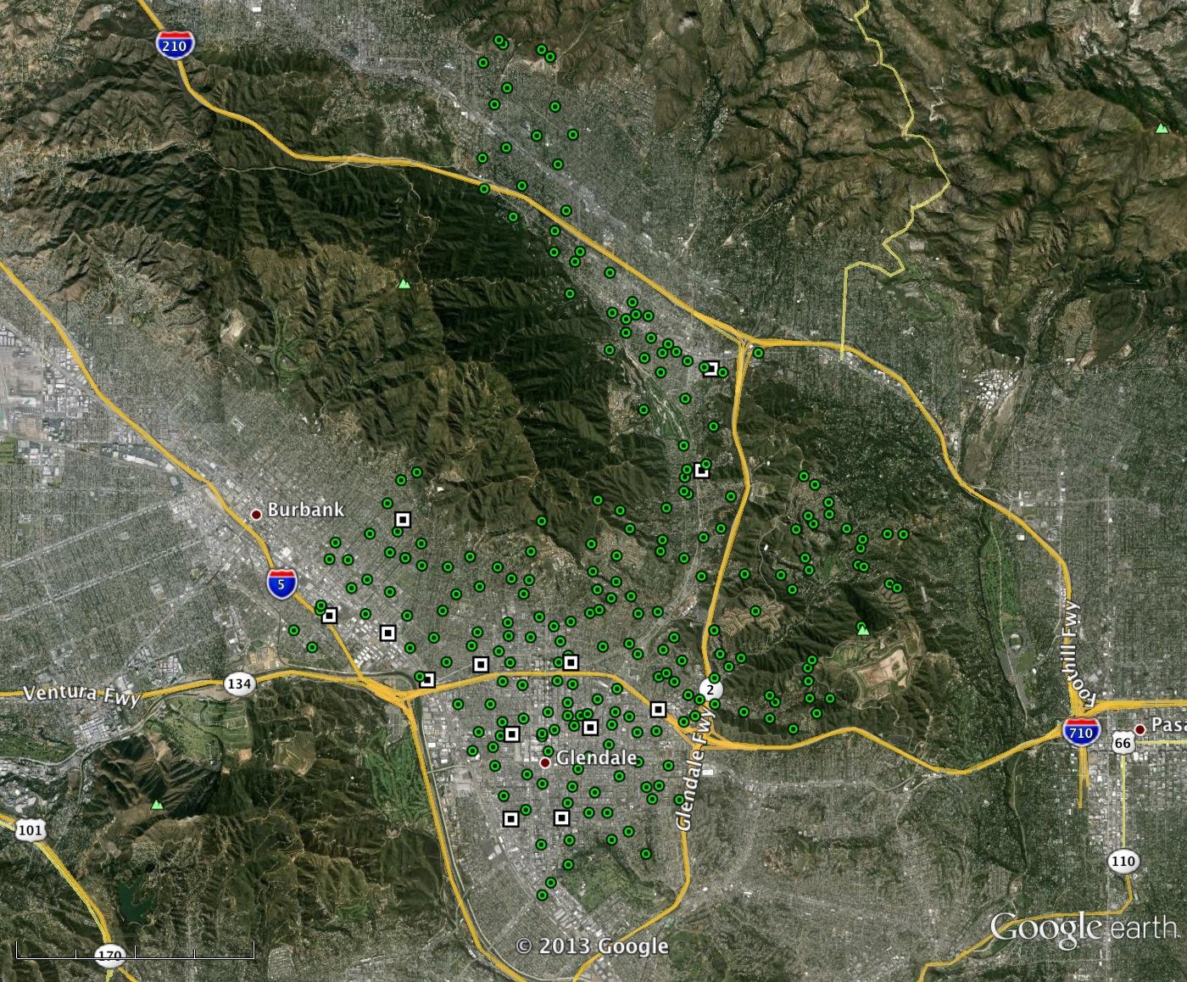
Geography – Urban/Suburban Mixed
Notes:
245 routers

Slide 7
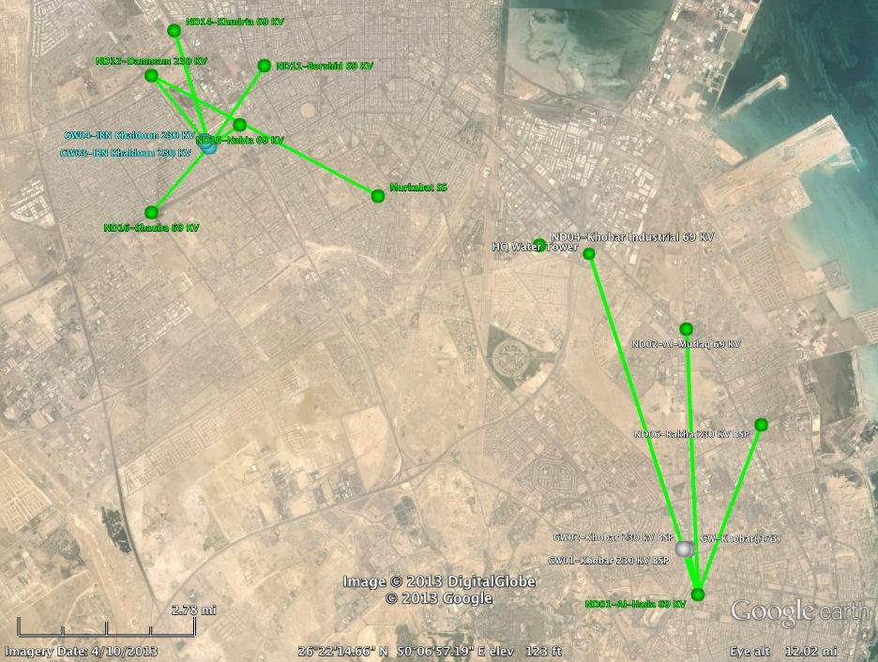
Geography – Urban/Suburban Mixed
Notes:
15 router pilot

Slide 8
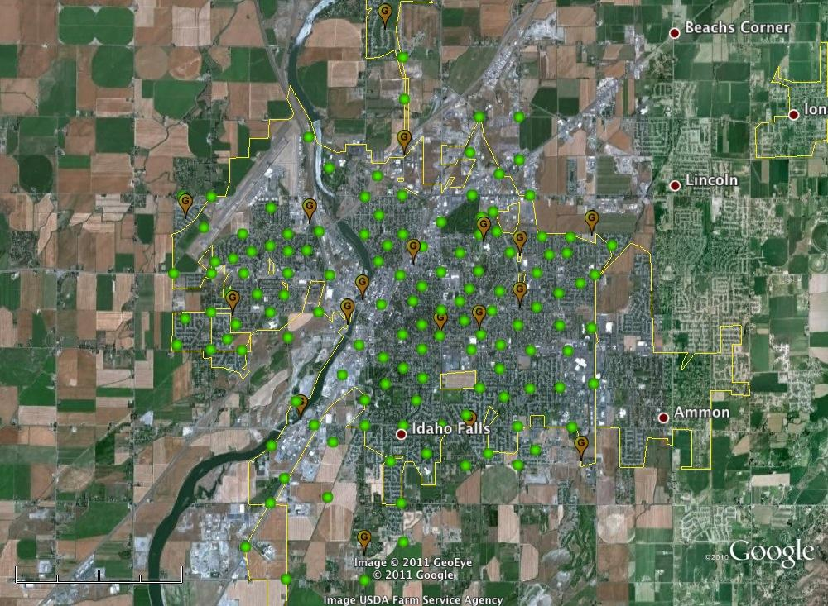
Geography –Suburban
Notes:
130 routers

Slide 9
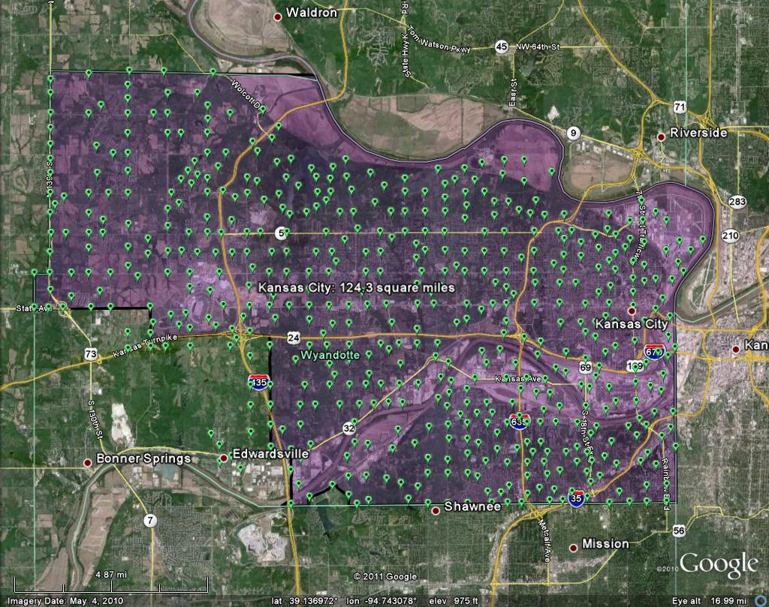
Geography –Suburban
Notes:
532 routers

Slide 10
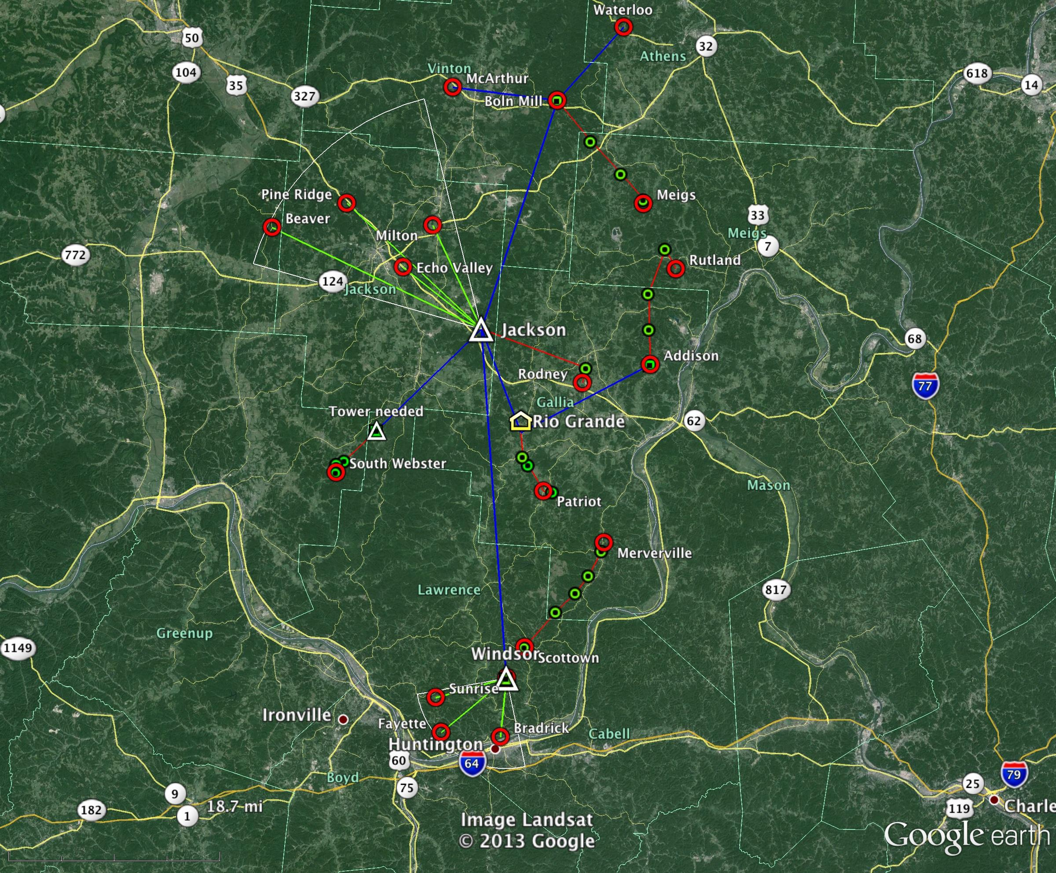
Geography – Rural
Notes:
3 PTP links, 2 PTMP sectors, 26 mesh routers

